Slide 1
Let's talk about
UNEMPLOYMENT
Fernanda Duhne

Slide 2
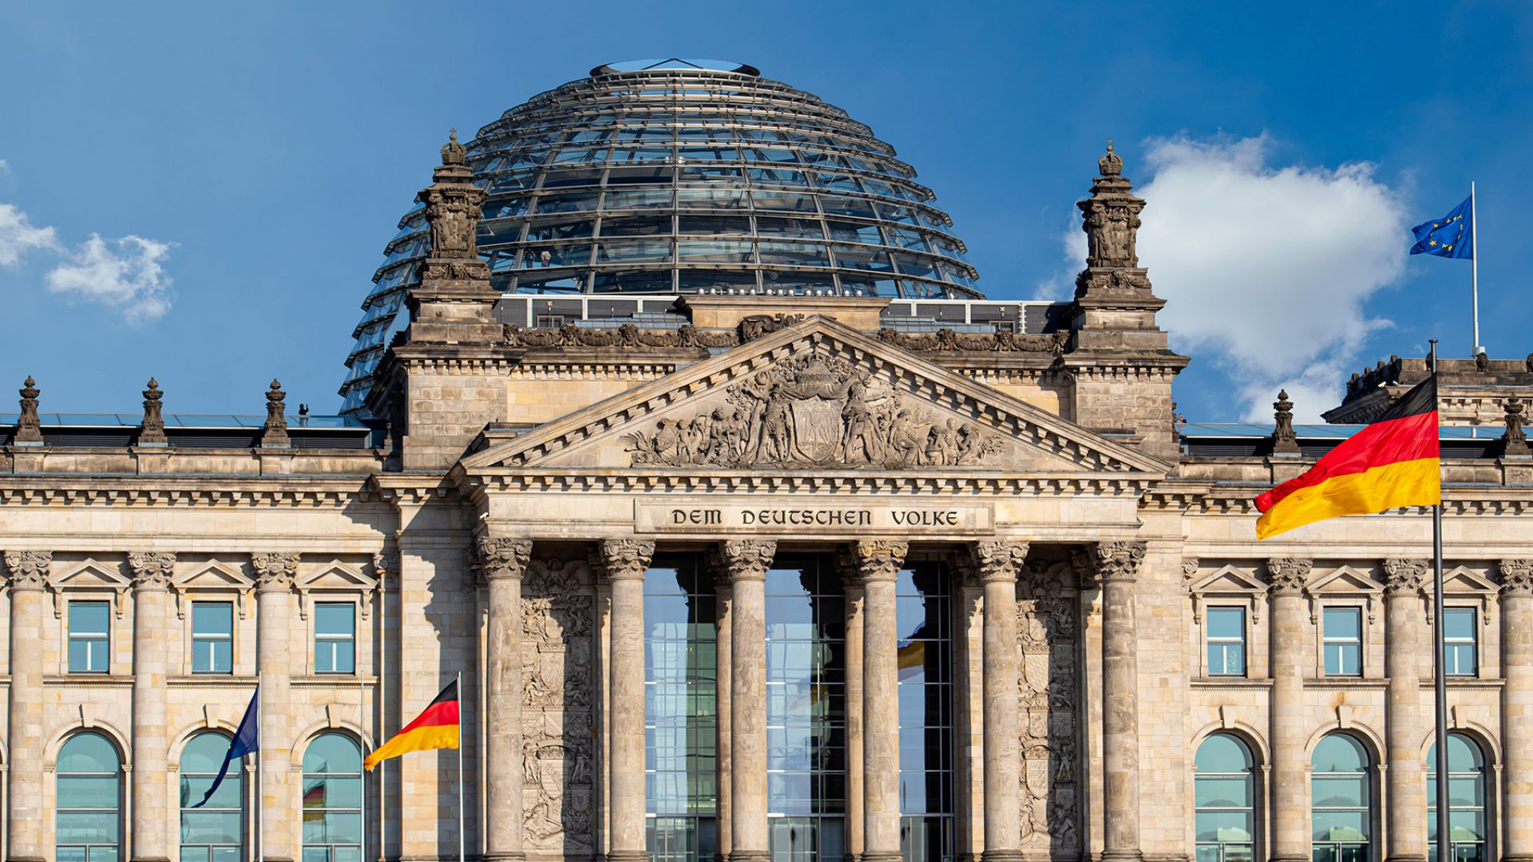

Slide 3
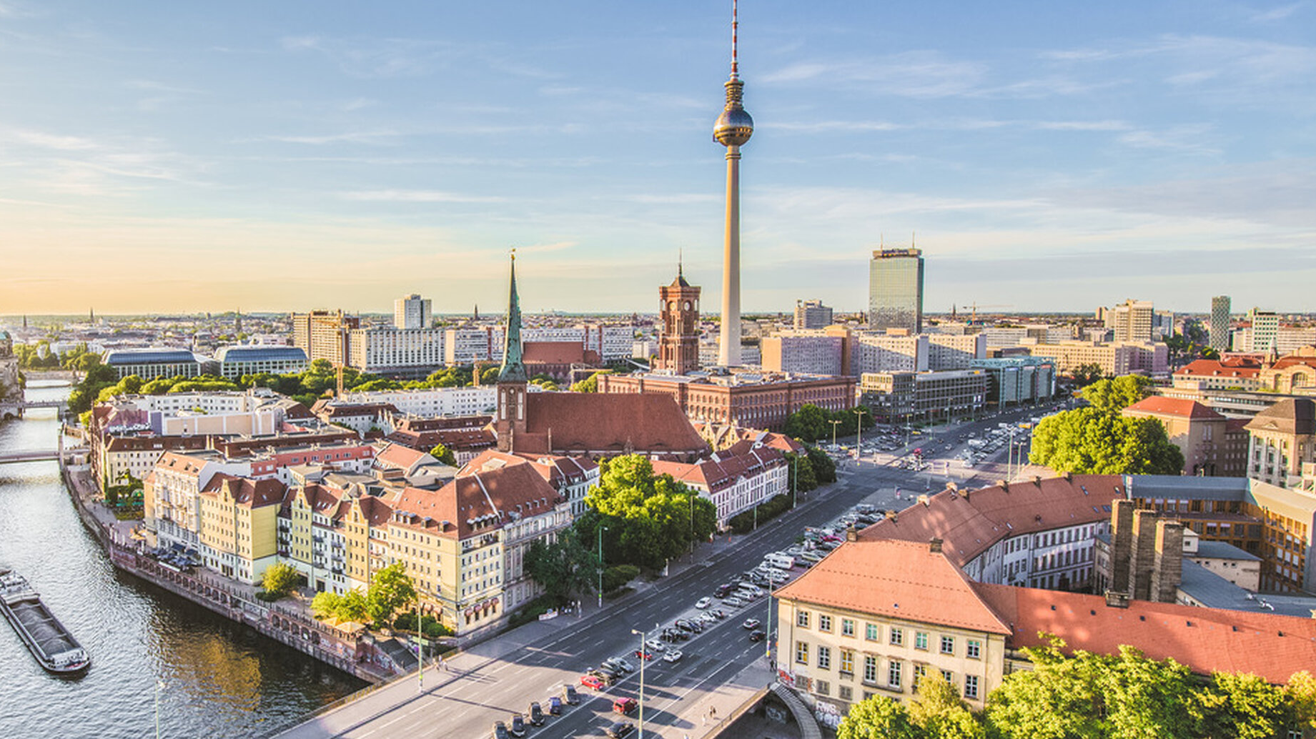
UNEMPLOYMENT BENEFITS

Slide 4
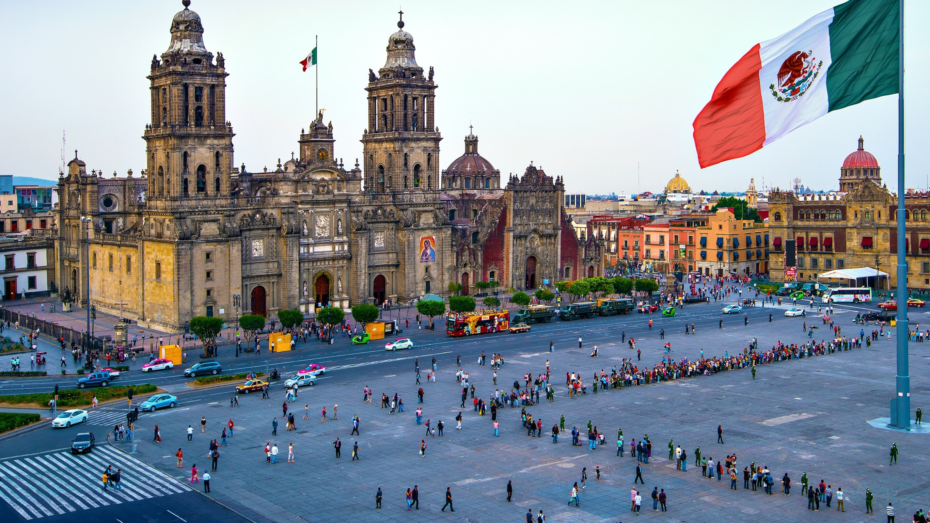

Slide 5
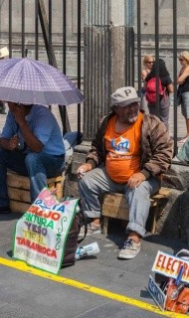
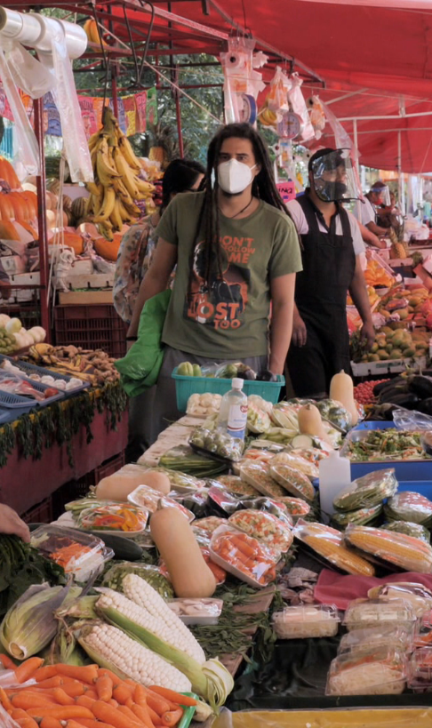
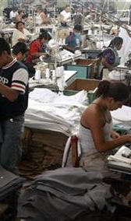
NO WORK = NO MONEY = NO FOOD

Slide 6

Do subsidies have an influence on unemployment in Berlin?

Slide 7
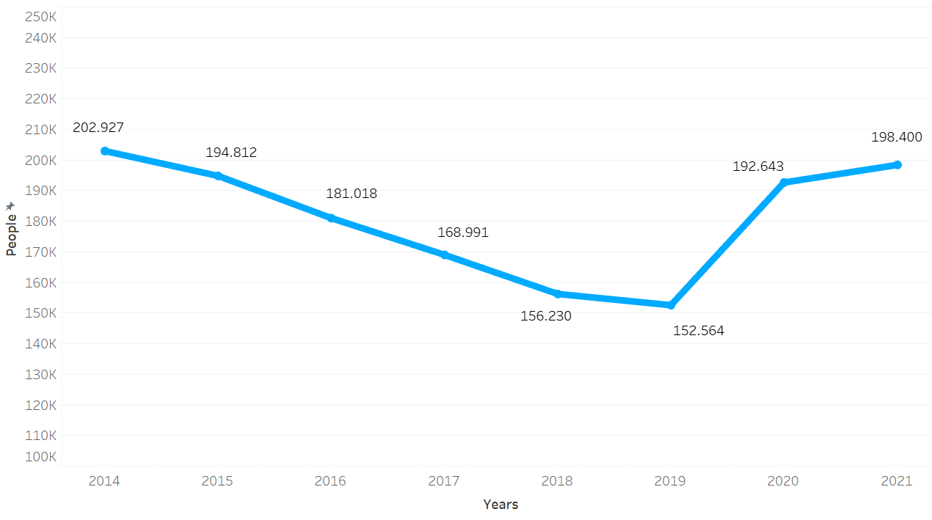
Unemployed people in Berlin
≈ 40.000
≈ 11.500
≈ 3700
1/3

Slide 8
Types of grants
34
Research
Traffic
Science
Economy
Education
Urban development
Culture
Environment
Churches, Religious and philosophical communities
Work
Finances
Youth
Media
Sports
Family
Social
Health
Integration
Women
Equality
Consumer protection
Justice
Monument protection
Anti-discrimination
Building, Housing
Berlin image
Security, order
Europe
Care
Civic engagement, citizen participation
International
Culture
Animal welfare
Civic engagement, citizen participation

Slide 9



Work
Education
Equality

Slide 10
Grant distribution
Year | Work | Education | Equality
2014 | 83.482.071,00 € | 25.998.681,00 € | 20.000,00 €
2015 | 68.834.801,00 € | 32.812.083,00 € | 16.503,00 €
2016 | 63.956.079,00 € | 37.572.765,00 € | 10.031,00 €
2017 | 98.521.097,00 € | 80.768.795,00 € | 57.911.693,00 €
2018 | 386.267.417,00 € | 94.117.552,00 € | 46.430.695,00 €
2019 | 241.366.750,00 € | 56.030.853,00 € | 36.705.550,00 €
2020 | 452.273.412,00 € | 88.646.992,00 € | 39.960.219,00 €
2021 | 452.271.489,00 € | 121.972.561,00 € | 44.359.684,00 €

Slide 11
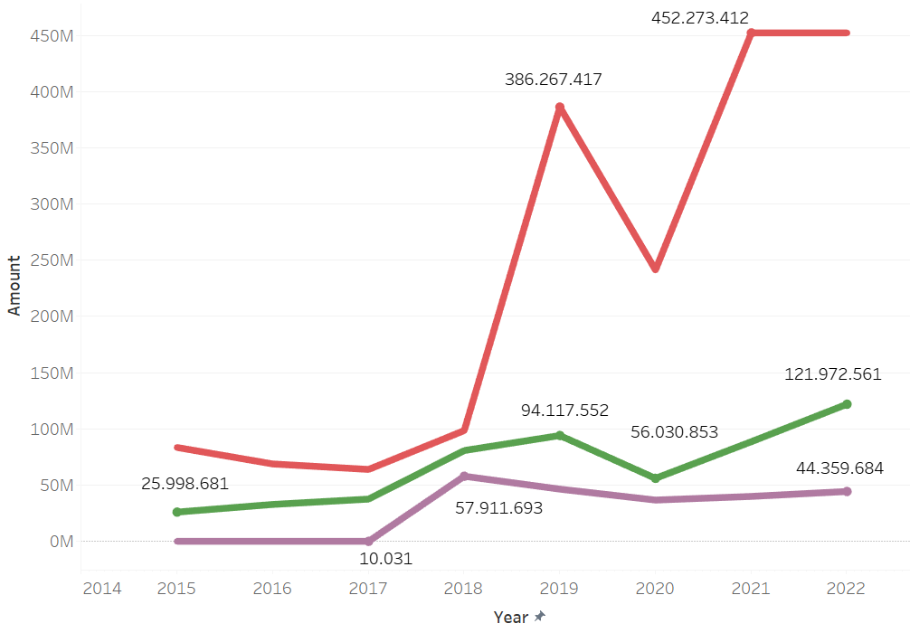
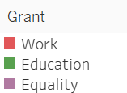
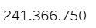
Grant distribution

Slide 12
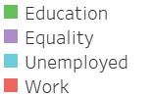
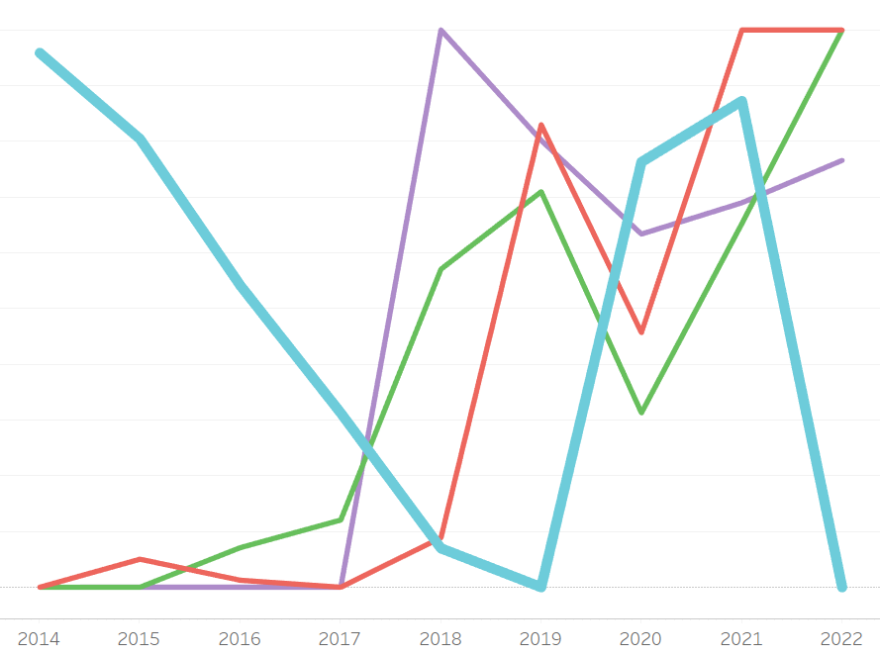
Relationship between unemployment and subsidies

Slide 13
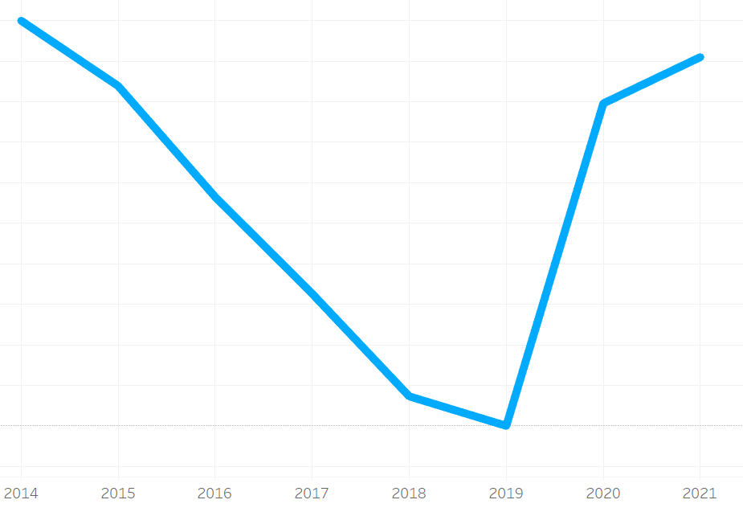
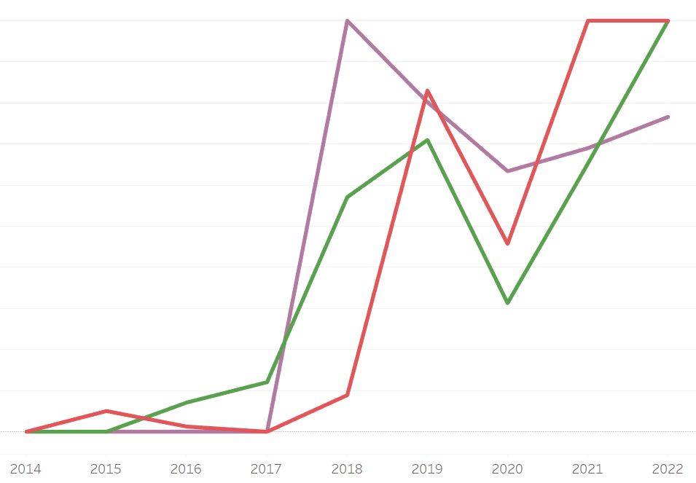
Relationship between unemployment and subsidies

Slide 14
Relationship between unemployment and subsidies

Slide 15
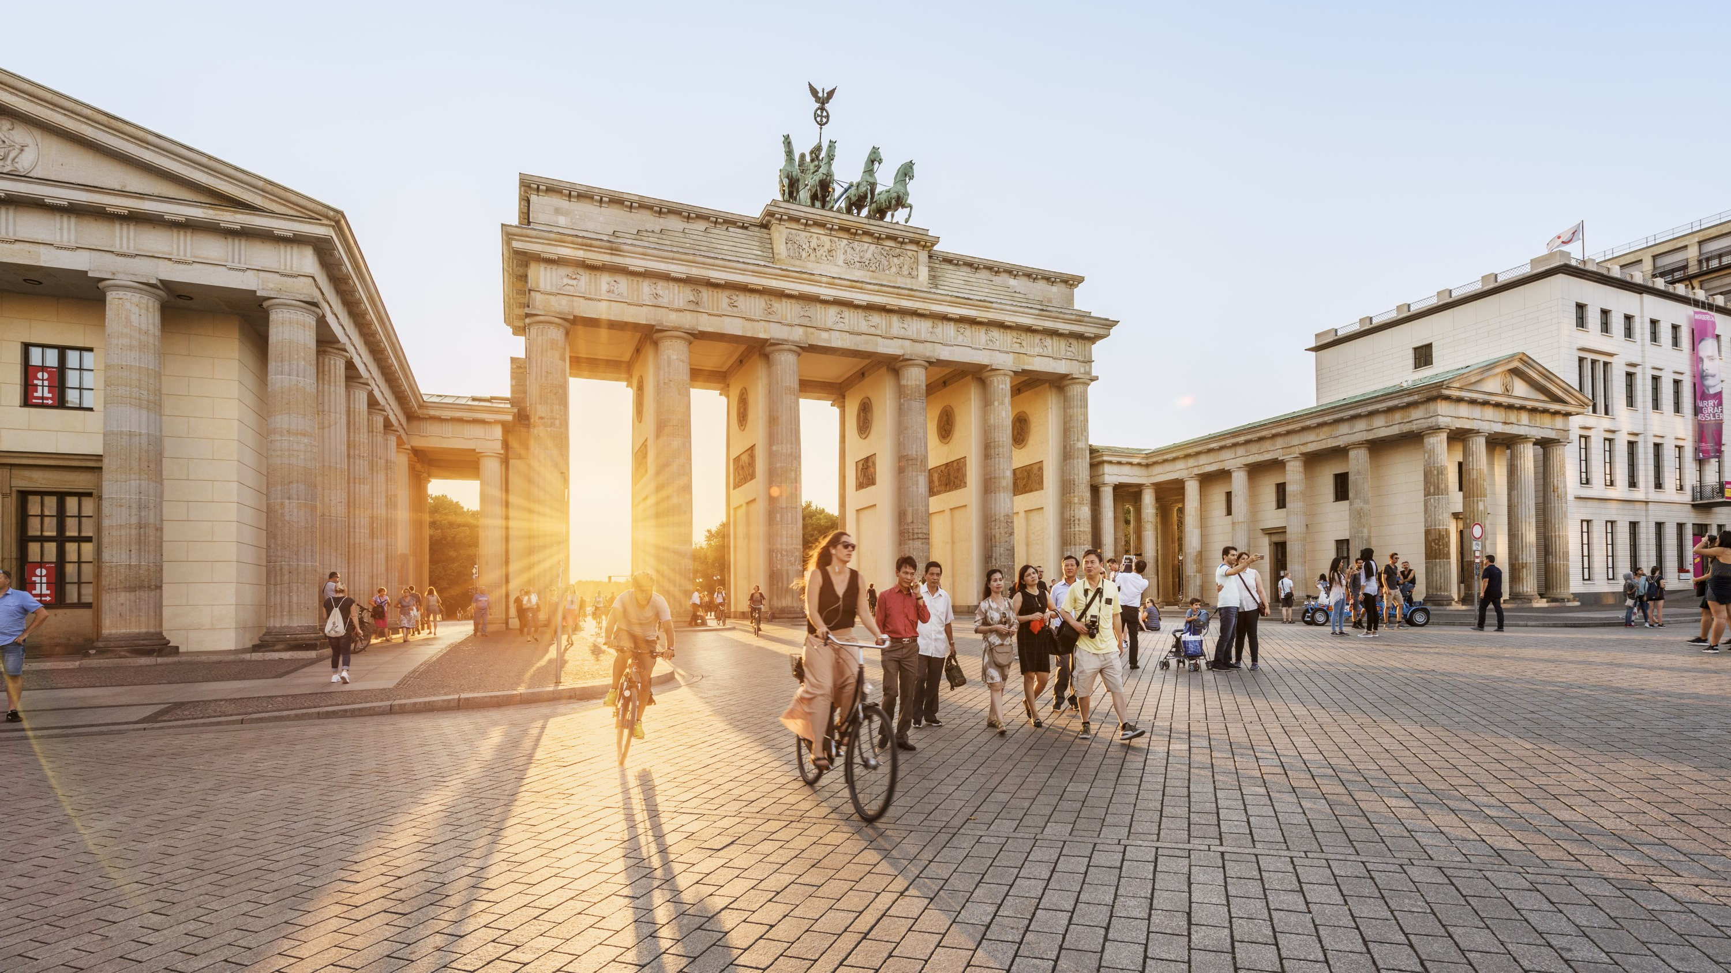

Do subsidies have an influence on unemployment in Berlin?

Slide 16

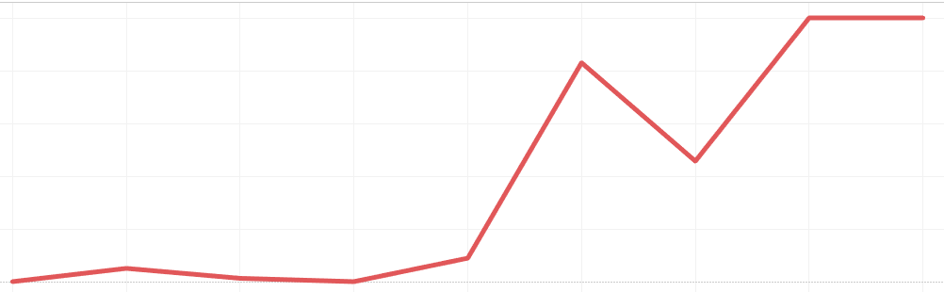
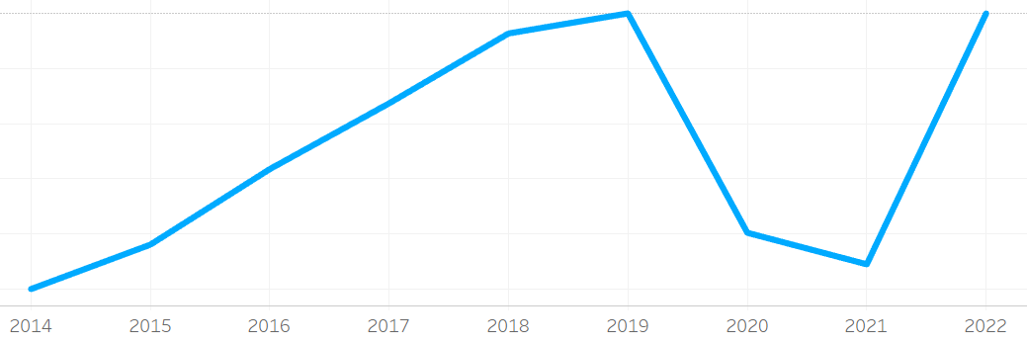

Slide 17


